Slide 1
The Political Economy of the Rent- Seeking Society
Written by Anne O. Kruger
Presented by Jiaxi Zhang

Slide 2
Two Types of Rent-Seeking
Legal rent seeking
Import license
Illegal rent seeking
Bribery

Slide 3
Three Cases of Competitive Rent -Seeking
These competitive rents originate from quantitative restrictions upon inter-national trade.
Competitive rent seeking leads to the operation of the economy inside its transformation curve
Welfare loss associated with quantitative restrictions is unequivocally greater than the loss from the tariff equivalent of those quantitative restrictions
Competitive rent seeking results in a divergence between the private and social costs of certain activities.

Slide 4
Before Rent-Seeking
Tariff is equivalents to quantitative restriction
It is difficult to find empirically observable measures of the degree to which rent seeking is competitive.

Slide 5
Competitive Rent-Seeking Mechanism
Import Licensing Mechanism
Licenses for imports of intermediate goods are allocated in proportion to firms' capacities.
Licenses for imports of consumer goods are allocated pro rata in proportion to importers-wholesalers.
Licenses are authorized by officials.
Notes:
For import licensing mechanism: even with initial excess, a rational entrepreneur may still expand his plant if the expected gains from the additional import licenses he will receive.

Slide 6
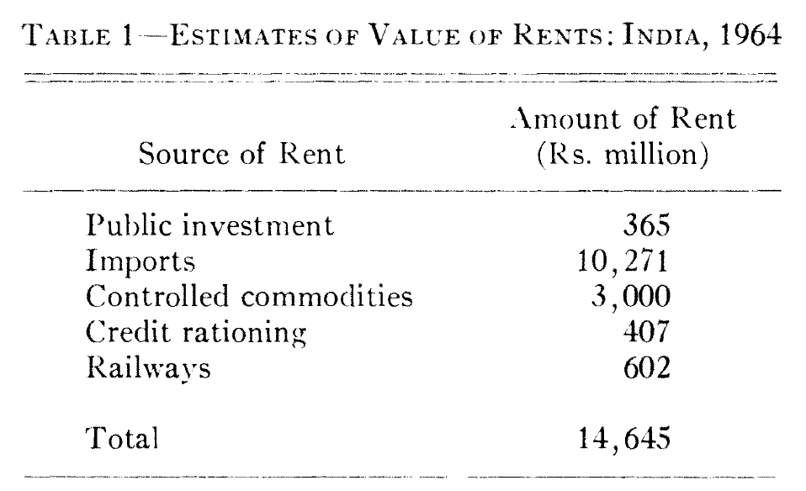
Evidence from India
The total value of rents of Rs. 14.6 billion contrasts with Indian national income of Rs. 201 billion in 1964, 7.3 percent of national income.

Slide 7
Evidence from Turkey
Imports in 1968 were recorded as 6 percent of national income. Rents from import licenses in Turkey in 1968 were about 15 percent of GNP
Landed cost: price plus all duties, taxes, and landing charges
Value of Import | 547 million
Value of Landed Cost | 1,443 million
Value of Wholesale | 3,568 million

Slide 8
Basic set up
Free trade model
Tariff or an import restriction model without rent seeking
Tariff or an import restriction model with rent seeking
Welfare loss from rent seeking

Slide 9
Basic set up
Two sector:
Agriculture: produce food for domestic consumption & export
Distribution: import consumption good Distribution output, D, is defined to equal the level of consumption-goods imports, M=D

Slide 10



Basic set up
Agriculture production function
Labor endowment L_{R} is the quantity of labor engaged in rent seeking.
Labor demand for distribution sector

Slide 11



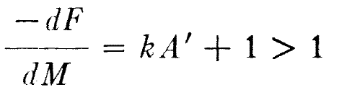
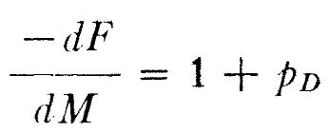
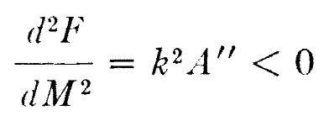
Free trade
Wage rate from f.o.c
No rent seeking
Consumption possibility frontier
Marginal rate of trans-formation

Slide 12
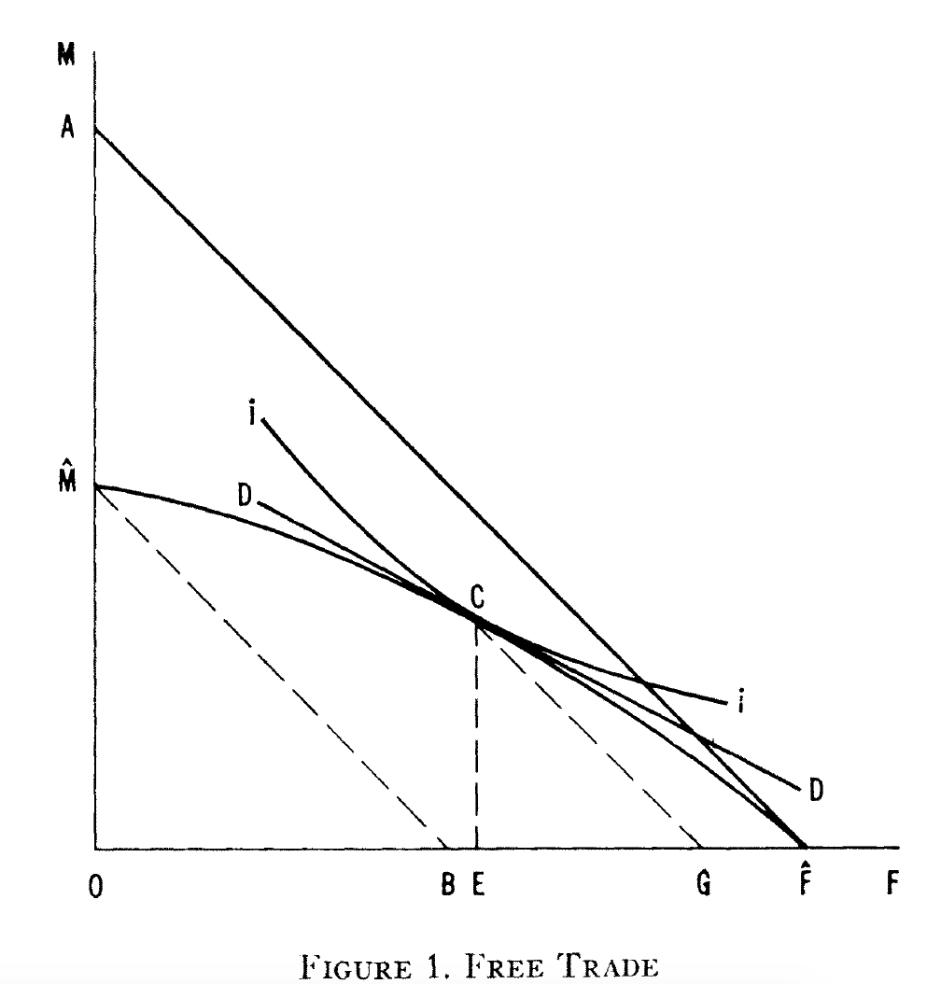
Free trade
Cost of distribution bending the consumption possibility frontier fro A to Mbar

Slide 13

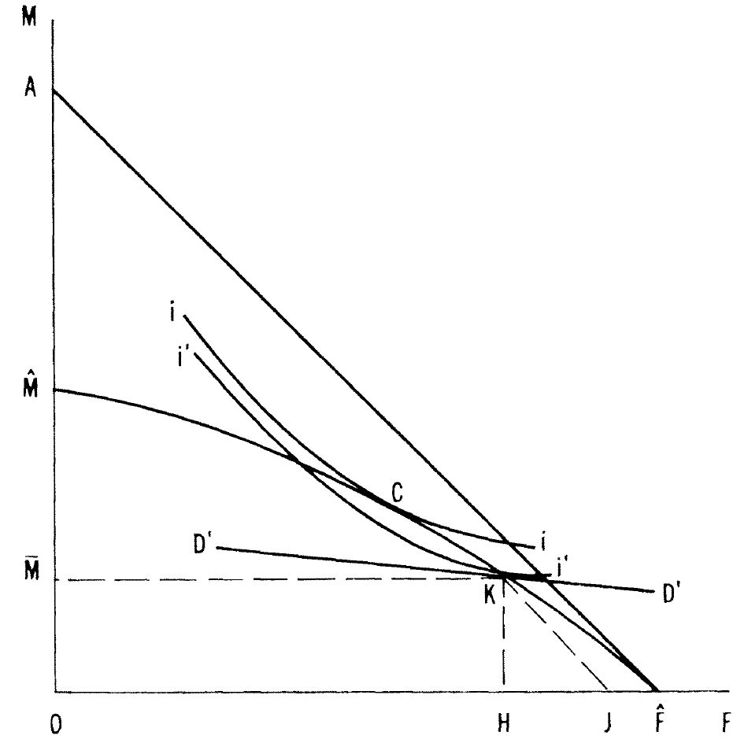
Tariff or an import restriction model without rent seeking
Import restriction

Slide 14
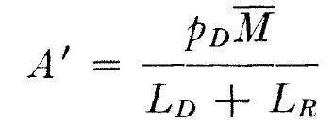
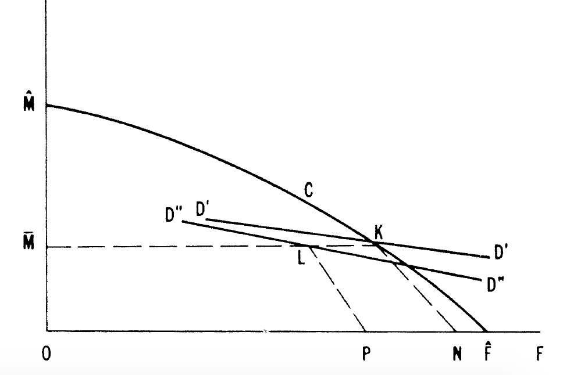

Tariff or an import restriction model with rent seeking
Wage equivalence
L_{D} successful seeker L_{R} unsuccessful seeker
Agricultural production and food consumption are reduced by the introduction of rent seeking

Slide 15

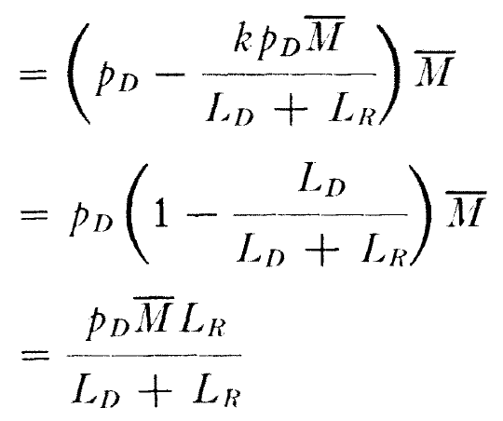

Welfare loss from rent seeking
The rent per import license
The total value of rents
The welfare cost of quantitative restrictions equals that of their tariff equivalents plus the value of the rents

Slide 16
Conclusion
Import prohibition might be preferable to a non-prohibitive quota.
The more inelastic domestic demand the less is likely to be the welfare cost of a given tariff. On contrary, the greater will be the value of rents and the greater, therefore, the deadweight loss associated with rent seeking.

Slide 17
Effect of several policies
Import licenses constitute a large and visible rent resulting from government intervention.
Fair trade laws result in firms of less-than-optimal size.
Minimum wage legislation generates equilibrium levels of unemployment above the optimum with associated deadweight losses.
Ceilings on interest rates and consequent credit rationing lead to competition for loans and deposits and/or high-cost banking operations.
Capital gains tax treatment results in overbuilding of apart-ments and uneconomic oil exploration

Slide 18
Policy Implication
Government dilemma "showing favoritism" to one group or competitive rent
Perception effect Rent seeking affects people's perception of the economic system.
Rent-generating restrictions With no restrictions, the windfall could be achieved by adopting new technology, anticipating market shifts correctly, and so on. With perfect restrictions, rent seeking would be the only route to gain the windfall.

Slide 19
Comment
This paper gave a general theoretical description of the competitive rent seeking behavior and its influence on welfare.
The social optimal consumption bundle and social welfare was compared three models – free trade, Tariff or an import restriction with and without rent seeking. The comparison showed a explicit picture of the difference between these three models.

